Slide 1
Unit 201: Health and safety in building services engineering
Asbestos

Slide 2
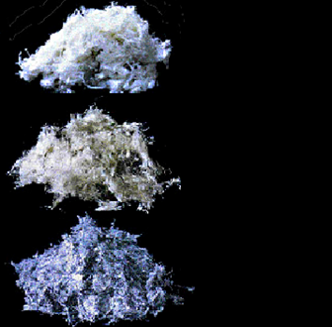
Asbestos
Chrysotile (white)
Amosite (brown)
Crocidolite (blue)

Slide 3
Asbestos
Effects on health:
lung cancer
mesothelioma
asbestosis.
Delay between first exposure and the start of the disease can vary from 15 to 60 years.

Slide 4
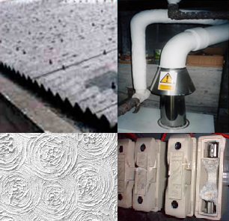
Asbestos
Asbestos was used in a variety of applications, including:
In decorative finishes (aertex, plaster, floor tiles)
In accessories (flash guards and matting in fuse carriers and on distribution board covers)
In insulation storage compartments, vessels and pipework.

Slide 5
Asbestos
What do I do if I suspect asbestos?
If you are in any doubt about whether the material you are working with contains asbestos, stop work and find out.
Assume that anything that looks like asbestos is asbestos.
The person in charge of the job must investigate whether there is any asbestos on site.

Slide 6
Asbestos
What do I do if I suspect asbestos?
Do
Keep asbestos-containing materials damp whilst you work on them.
Only use hand tools.
USE PPE, including a respirator – a dust mask will not provide adequate protection.
Clean up as you go along; don’t pile up waste.
Use a special ‘Type H’ vacuum cleaner.
Always wash your hands and face if you take a break and the end of the day.

Slide 7
Asbestos
What do I do if I suspect asbestos?
Don’t
Use power tools, as they create more dust.
Take overalls home to wash – use only the disposable type.
Eat or drink in the work area.
Smoke, as the risk of lung cancer from asbestos is higher among smokers.

Slide 8
Asbestos
What do I do if I’m in charge?
Prevent exposure to asbestos or reduce it to the lowest level possible by using suitable control methods.
Ban the use of power tools.
Dampen the material.
Enclose the work and use dust extraction equipment.
Identify the area of concern.

Slide 9
Asbestos
How should asbestos be disposed of?
Asbestos is hazardous waste; it must be packaged and labelled as such and taken to a licensed waste disposal site.

Slide 10
Unit 201: Health and safety in building services engineering
The End

